Slide 1

Shipping System

Slide 2
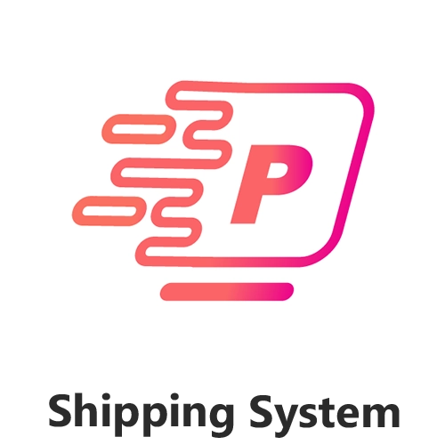
Shipping System Management

Slide 3
Agenda
Introduction
Project Overview
Technical Implementation
Demonstration
Future Enhancements
Challenges and Solutions
Conclusion

Slide 4
Introduction

Slide 5
Introduction
Team Members :
Mahmoud Taha Mahmoud
Mohamed Abdel Wahab Kandel
Rizk Ahmed Rizk
Mostafa Ahmed Abdelsalam
Mohamed Nabil Gomaa
Salah Mohamed Abdelhamid

Slide 6
Introduction
Project Purpose :
The purpose of the Shipping Management System is to provide an efficient and streamlined solution for managing shipping operations. It aims to automate various tasks involved in the shipping process.
Project objective :
Centralized Management
User-friendly and automated system
Ensuring effective invoice management

Slide 7
Project Overview

Slide 8

Project Overview
Trader: Simplifies order creation, tracking, and delivery management.
Employee: Streamlines administrative tasks and enhances operational efficiency.
Representative: Provides easy access to assigned tasks and real-time updates.
Pain points: Manual processes, lack of coordination, time-consuming tasks.
Target users: Traders, employees, representatives in shipping companies.
User Management: Effortlessly manage user roles and permissions.

Slide 9
Technical Implementation

Slide 10
Technical Implementation
What did we use? And why?

Slide 11
Technical Implementation: Utilizes .NET Core MVC
Advantages of the Chosen Technology:
We used MVC because it meets the Requirements of the system
A main advantage of MVC is separation of concern. Separation of concern means we divide the application Model, Control and View.
We can easily maintain our application because of the separation of concern.
In the same time we can split many developers work at a time. It will not affects one developer work to another developer work.

Slide 12
Demonstration

Slide 13
Future Enhancements

Slide 14
Future Enhancements
What will we do in future:
Improved User Interface / User Experience.
Social Media Integration.
Data Analytics and Reporting.
Making Chat Between Users.
Notifications For Users.

Slide 15
Challenges & Solutions

Slide 16
Types of Challenges
Business Challenges:
Understanding the business of the project.
Technical Challenges:
Git & GitHub
Identity

Slide 17
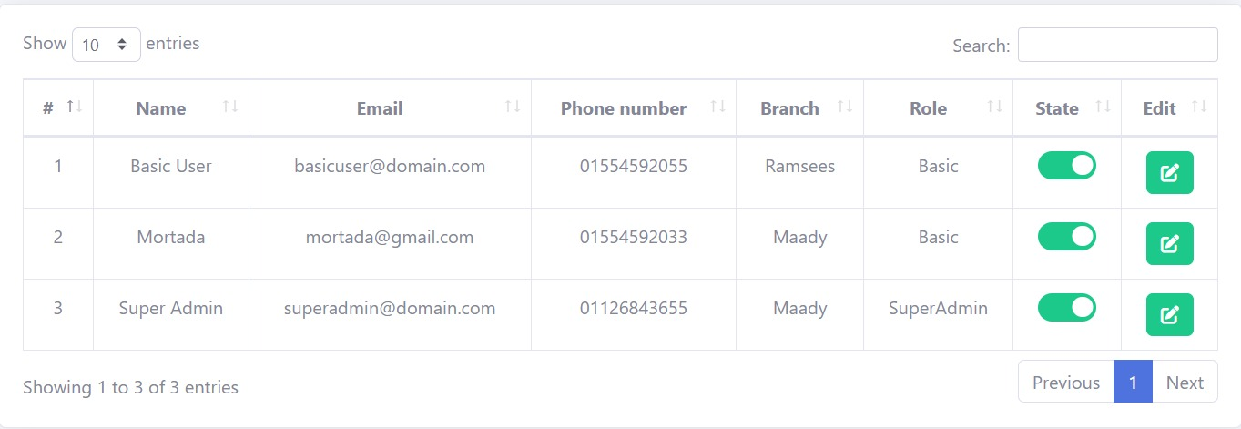
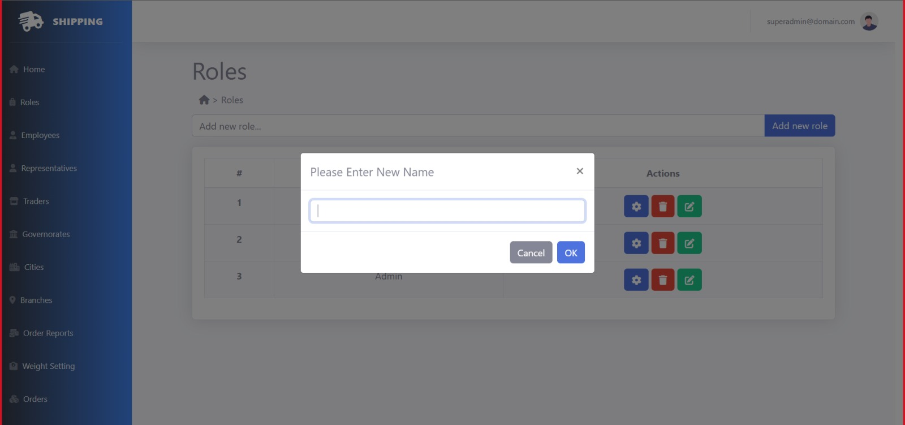
Smart Solutions
Data Table(Bootstrap &jQuery)
Boot Box (jQuery)

Slide 18
Conclusion

Slide 19
THANK YOU

